Slide 1
University of Basrah Al-zahraa medical college
Ministry of higher Education and Scientific Researches
The module: URINARY SYSTEM MODULE
Session 8 Lecture 1
MODULE STAFF:
Prof.Mahmood Shakir Dr.Adnan Othafa Ass.Prof.Firas Shakir
Dr. Safaa Almatook Dr.Khaldoon Sadek
Control of Micturition
For more detailed instruction, any question, cases need help please post to the group of session.
Clinically Orientated Anatomy Moore KL ,DalleyAF&Agur AMR
Publisher:Lippincott Williams and Wilkins:Seventh Edition: ISBN:9781451184471

Slide 2
University of Basrah Al-zahraa medical college
Ministry of higher Education and Scientific Researches
Learning out come
1-anatomy
2-innervation
3-normal physiology
4-abnormality
For more detailed instruction, any question, cases need help please post to the group of session.

Slide 3
Anatomy the bladder is the organ responsible for micturition (the process of emptying after filling of the bladder) the muscle in the bladder is of the smooth type of muscles arranged in layers that are in right angle to each other to give strength to sustain the pressure that develop while the bladder fill grossly the bladder is a chamber consisting of two main parts : 1-the body large capacity for urine collection 2- the neck the funnle shaped extension of the bladder
University of Basrah Al-zahraa medical college
Ministry of higher Education and Scientific Researches
LO1
For more detailed instruction, any question, cases need help please post to the group of session.

Slide 4
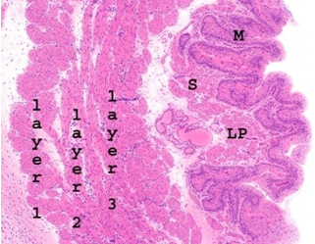
University of Basrah Al-zahraa medical college
Ministry of higher Education and Scientific Researches
LO2
For more detailed instruction, any question, cases need help please post to the group of session.

Slide 5
The detrusor muscle ; smooth muscle fibers ,the cells are close to each other allowing action potential to spread rapidly the contraction produce pressure of about 40-60mmHg
University of Basrah Al-zahraa medical college
LO1
The contraction thus occur at once to the whole bladderThe trigone it is a triangular area at the posterior wall of the bladder ,it is apex is lower down directed inferiorly to connect to the posterior urethra while its base is landmarked by the two ureteric openingsThe bladder neck (posterior urethra) is 2-3 cm long its mucosa is surrounded by smooth muscle +ilastic tissue =internal sphincter
For more detailed instruction, any question, cases need help please post to the group of session.

Slide 6
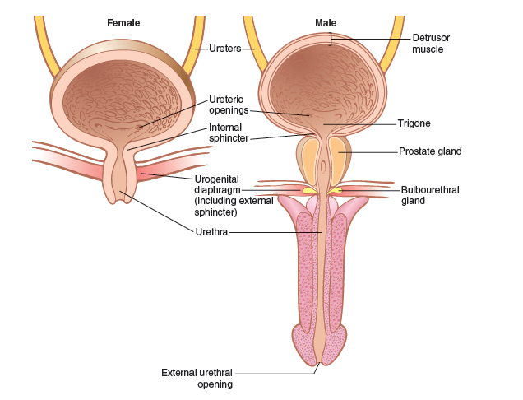
University of Basrah Al-zahraa medical college
Ministry of higher Education and Scientific Researches
LO1
For more detailed instruction, any question, cases need help please post to the group of session.

Slide 7
Innervation of the blasdder: the nerve supply of the bladder is through 1-the pelvic nerves that connect to the spinal cord through the sacral plexus mainly S2,S3 c arrying both sensory and motor supply 2-the pudendal nerve motor –to skeletal muscle sphencter 3- the hypogastric nerve sympathetic mainly L2 segment the pressure in the bladder when empty is = 0 the pressure is 5-10 mm water if the urine volume is 30-50 cc little change up to 200-300 cc sudden rise after 400cc
University of Basrah Al-zahraa medical college
Ministry of higher Education and Scientific Researches
LO2
For more detailed instruction, any question, cases need help please post to the group of session.

Slide 8
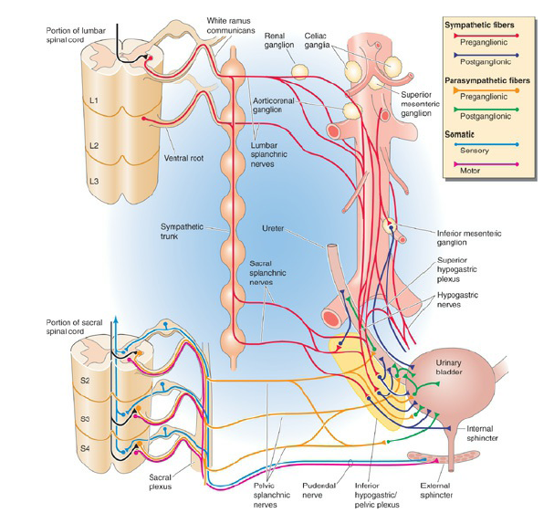
University of Basrah Al-zahraa medical college
Ministry of higher Education and Scientific Researches
LO2
For more detailed instruction, any question, cases need help please post to the group of session.

Slide 9
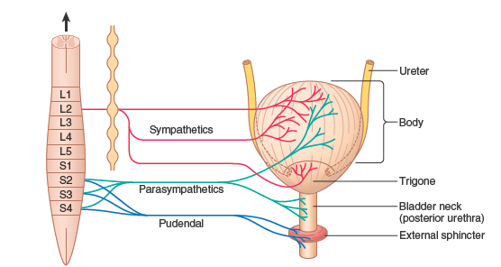
University of Basrah Al-zahraa medical college
Ministry of higher Education and Scientific Researches
LO2
For more detailed instruction, any question, cases need help please post to the group of session.

Slide 10
Micturition Reflex the reflex is intiated by strech receptors mainly at the post. Urethra bladder neck which get streched after filling of the bladder these signals are sensory travel by the pelvic nerve which return impulses through parasympathetic through same nerve the bladder has two phase detruser muscle activities a filling phase and a voiding phase in the filling phase the bladder accommodate urine with the elastic properties of the detruser muscle so only slight rise in its pressure occur at the beginning then there is a long phase of philling with no change in the bladder pressure
University of Basrah Al-zahraa medical college
Ministry of higher Education and Scientific Researches
LO3
For more detailed instruction, any question, cases need help please post to the group of session.

Slide 11
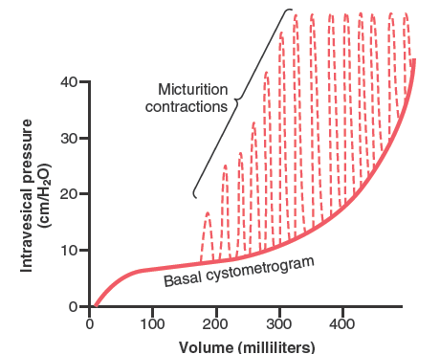
University of Basrah Al-zahraa medical college
Ministry of higher Education and Scientific Researches
LO3
For more detailed instruction, any question, cases need help please post to the group of session.

Slide 12
The detruser pressure low at start of filling only rise slightly with app.50cc the first sensation at 150cc flat study pressure during filling at 400cc there is sudden rise of pressure micturition reflex develop due to streaching of the bladder wall but it is inhibited the dtruser contraction which if not inhibited lead to voiding and emptying of the bladder during maturation the sphincter muscle relax
University of Basrah Al-zahraa medical college
Ministry of higher Education and Scientific Researches
LO3
For more detailed instruction, any question, cases need help please post to the group of session.

Slide 13
The micturition reflex has its afferent nerve through the pelvic nerve and the parasympathetic nerve also through the pelvic nerve both integrated at the sacral portion of the spinal cord. The reflex is an autonomic spinal cord reflex that is controlled by either facilitative or inhibitory impulses from the upper center in the brain areas in the brain stem maily pons have inhibitory and faciltiatoy function areas in the cerbral cortex have also both inhibitory as well as excitatory function in general the brain can 1- inhibit the reflex --- untile urination is desired 2-prevent urination ----voluntary contraction of the external sphincter 3-facilitate micturition----facilitate reflex and relax sphincter
University of Basrah Al-zahraa medical college
Ministry of higher Education and Scientific Researches
LO3
For more detailed instruction, any question, cases need help please post to the group of session.

Slide 14
Urination in voluntary urination the following occur: 1-abdominal muscle contraction 2-as a result the intrabdominal pressure increase leading to increase bladder pressure 3-as a result more urine inter the bladder neck and posterior urethra 4-this will stretch the receptors leading to initiation of micturition reflex 5- inhibition of the contraction of the external sphincter 6- emptying of the bladder
University of Basrah Al-zahraa medical college
Ministry of higher Education and Scientific Researches
LO3
For more detailed instruction, any question, cases need help please post to the group of session.

Slide 15
Abnormalities can affect one or more of the above described neuronal pathways: 1-afferent nerve only affected –atonic bladder –from crushed sacral spinal cord ,dorsal root damage,syphlis and tabes dorsalis 2-both afferent and efferent 3-spinal cord lesion above the sacral region the patient develop atonicity at the initial spinal shock state then followed by hyperactivity or uncontrolled conttactions
University of Basrah Al-zahraa medical college
Ministry of higher Education and Scientific Researches
LO2
For more detailed instruction, any question, cases need help please post to the group of session.

Slide 16
University of Basrah Al-zahraa medical college
Ministry of higher Education and Scientific Researches
LO2
For more detailed instruction, any question, cases need help please post to the group of session.

Slide 17
University of Basrah Al-zahraa medical college
Ministry of higher Education and Scientific Researches
LO2
For more detailed instruction, any question, cases need help please post to the group of session.

Slide 18
University of Basrah Al-zahraa medical college
Ministry of higher Education and Scientific Researches
For more detailed instruction, any question, cases need help please post to the group of session.

Slide 19
University of Basrah Al-zahraa medical college
Ministry of higher Education and Scientific Researches
For more detailed instruction, any question, cases need help please post to the group of session.

